Slide 1
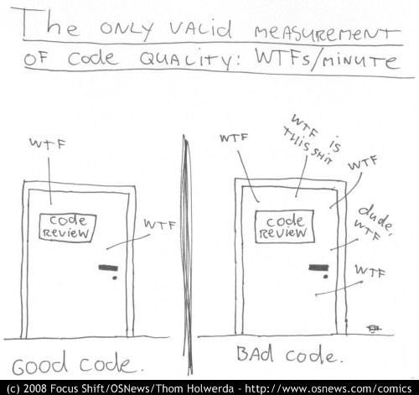
Refactoring towards testable code and happier developers ☺
@dave_mateer

Slide 2
http://persephonemagazine.com/2013/01/gif-it-to-me-baby-wtf/

Slide 5
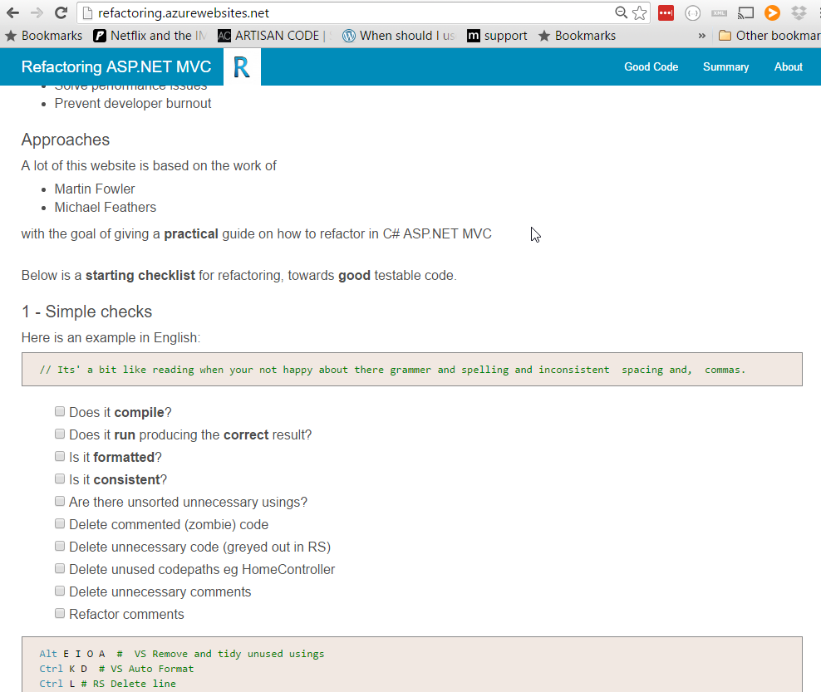
My practical guide (9 months) http:// refactoring .azurewebsites.net The good bits

Slide 6
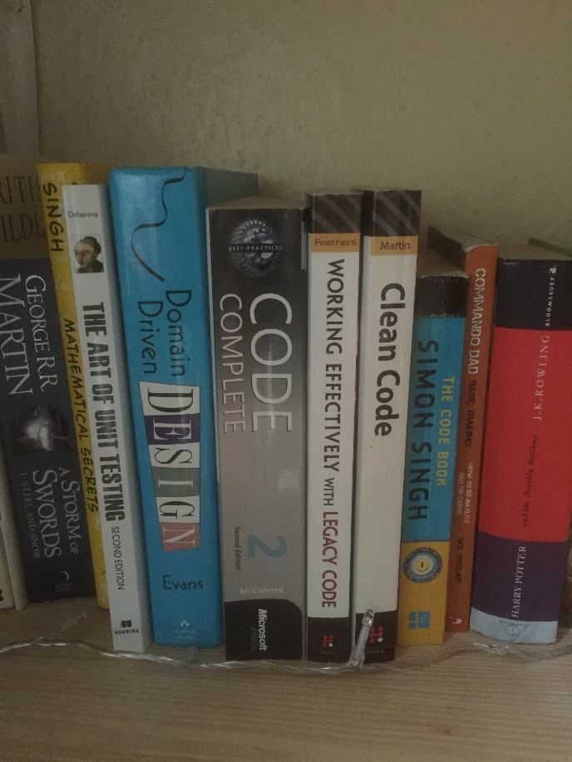


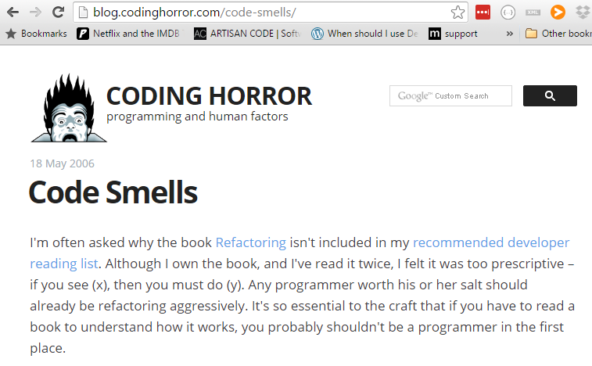
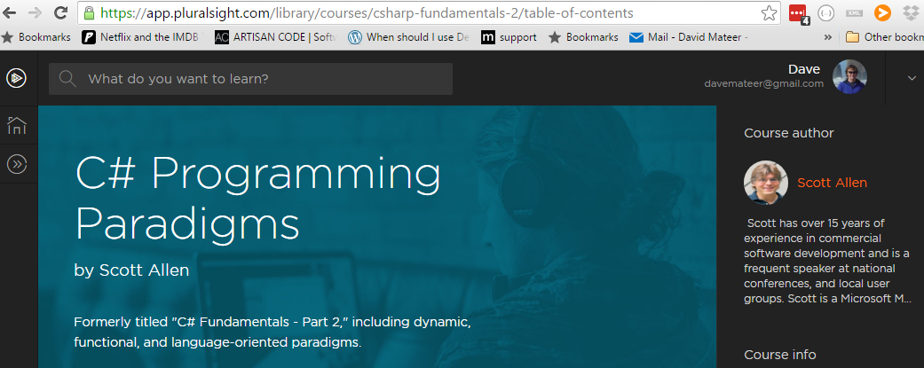
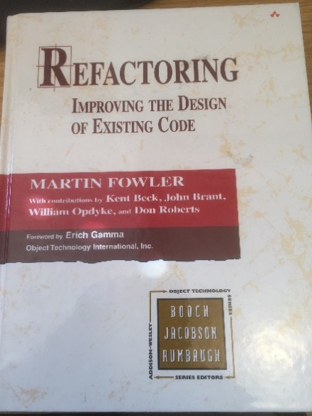
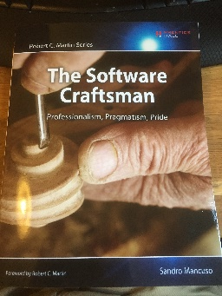
Stand on the Shoulders of Giants

Slide 7

1. Names
Solutions, Projects, Namespaces,
Classes / Files, Methods,
Parameters, Properties, Variables
Adds meaning to code

Slide 8
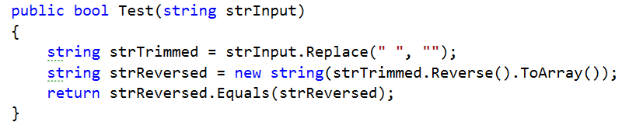
Palindrome tester: words which are the same forwards as reversed eg: noon
Also ignoring any whitespace eg no on
**Example based on K Scott Allen, Pluralsight, C# Programming 2011

Slide 9
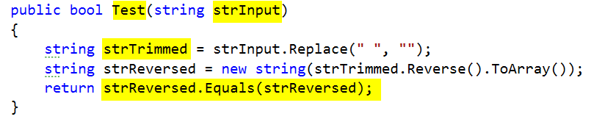
PascalCase convention for method names (C#) - good
Hungarian Notation eg strInput – bad
strTrimmed – trimmed generally means whitespace trim from beginning and end not middle – bad
Bug at the end – should be strTrimmed.Equals(strReversed) - bad

Slide 10
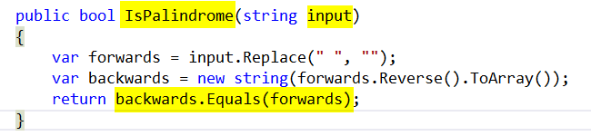
IsPalindrome – descriptive - good
input – simple - good
var keyword - good
Symmetry of final line – conveys exactly what IsPalindrome does - excellent

Slide 11
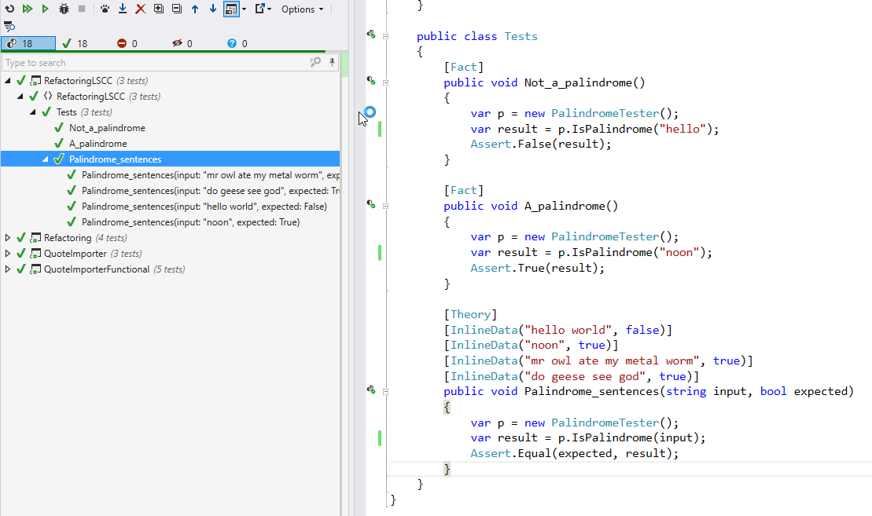

Slide 12

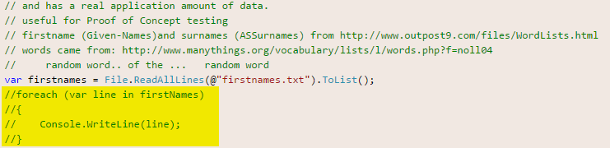
2.Killing Zombies
Kill Zombie (nearly dead) code
https://www.flickr.com/photos/dhollister/2596483147

Slide 13
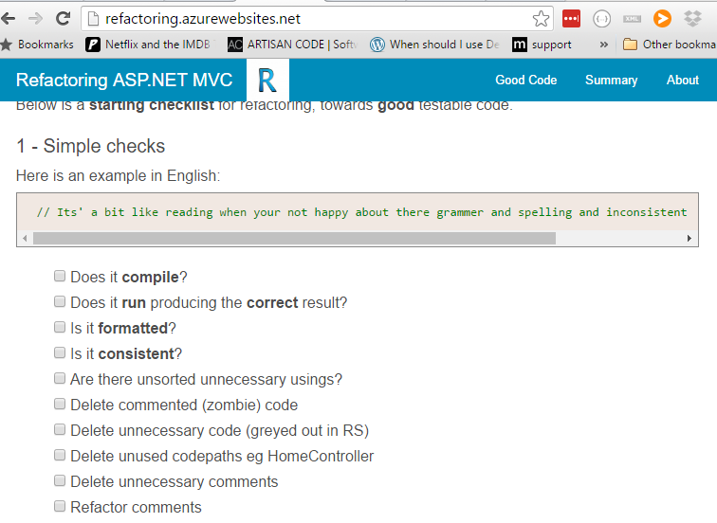

Slide 14

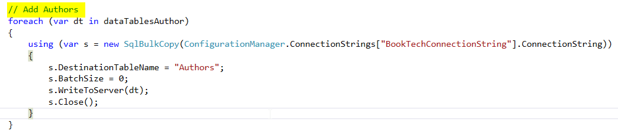
3.Minimise Comments
Candidate to refactor into a Method called AddAuthors?

Slide 15

4.Favour Short local scope names

Slide 16

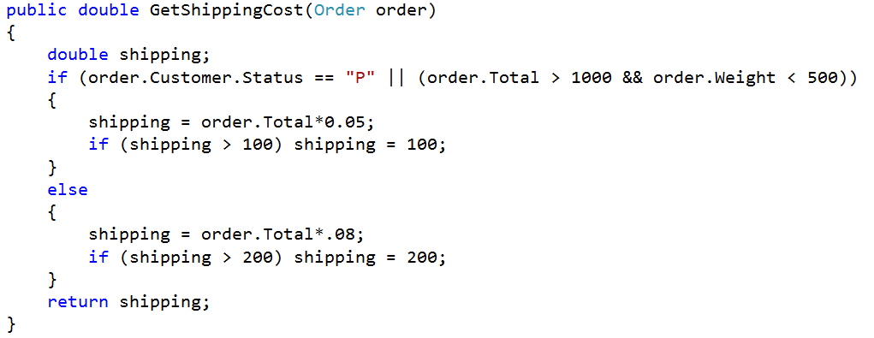
5. Encapsulate Complexity
Inspired by refactoring course on Lynda.com
Bmalarky https://flic.kr/p/9XWL8g

Slide 17
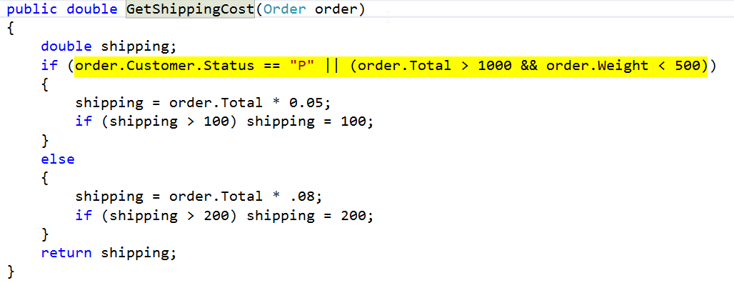
Ctrl R M – Extract Method

Slide 18
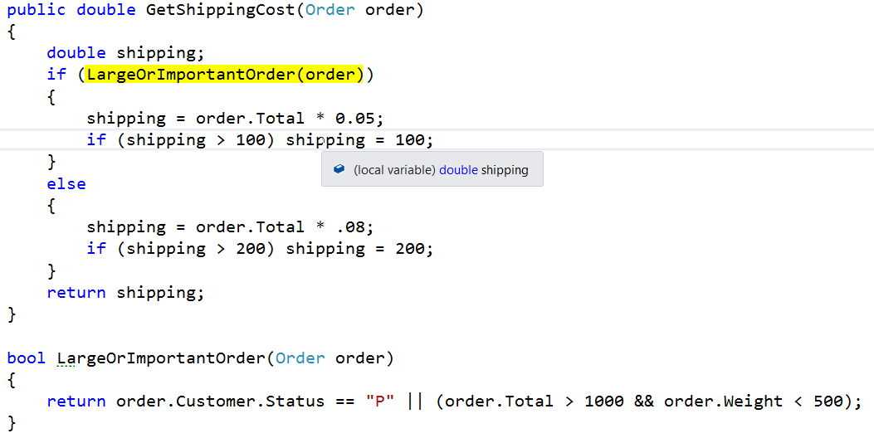

Slide 19
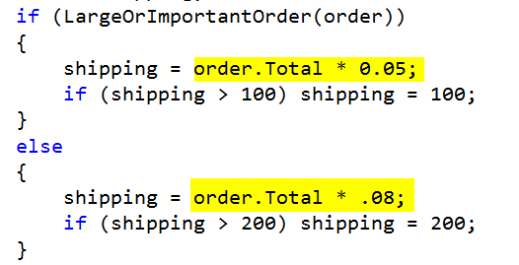
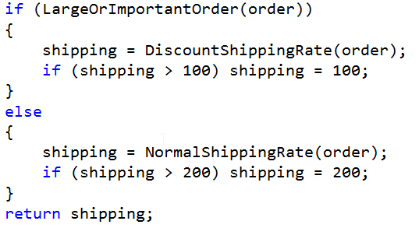

Slide 20
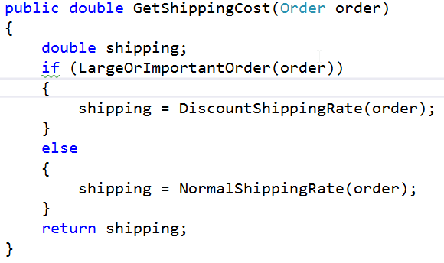
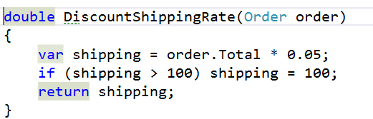
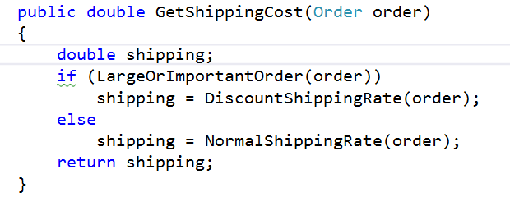

Slide 22
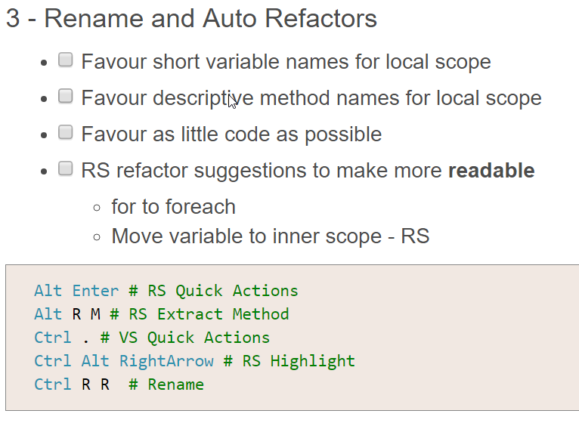
6.WebsiteTips
**move to website from here and talk through..

Slide 23
7.Automation / Tools
Win10 – new shell can copy and paste
code . – for a fast easy editor **DEMO**
.\d trick **DEMO**
Resharper 10 (Personal license okay to use inside work if you buy yourself)
Github Desktop (installs PoshGit – best command line client) **DEMO**
Bitbucket (free private git repos)
Github (public repos)
Appveyor (free build and test server)
Miniprofiler – to see speed of SQL Queries
Source control database (DB Project in VS)
VS2012.5 (inside current corporation)
SSDT to talk to SQL2014
Web tools so can use MVC5
Visio – for mock ups!

Slide 24

8.Refactoring towards Perf / Big Data / Simplicity
Years of junior developers coming into project who need to get up to speed asap
Simple is paramount
Sunny_mjx https://flic.kr/p/qGtWFw

Slide 25
Architecture

Slide 26
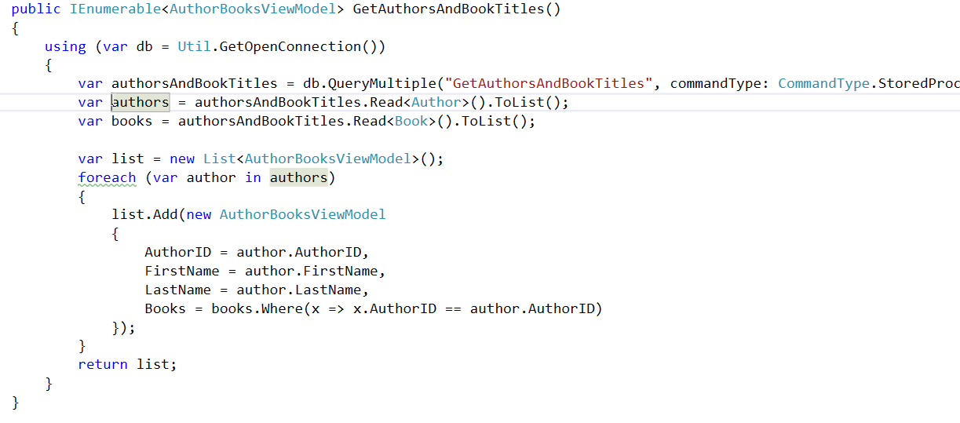
Queries (CQS)
A Command DOES something (and returns void), a Query RETURNS something (no side effects)

Slide 27
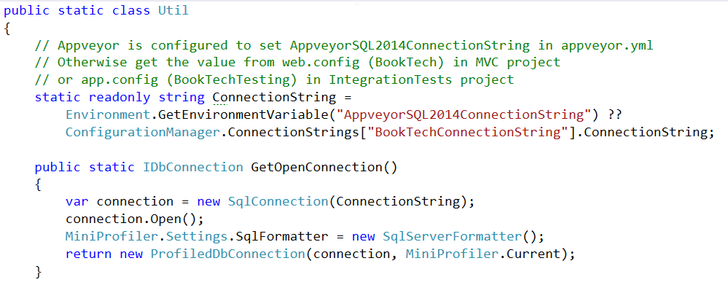
Connection

Slide 28
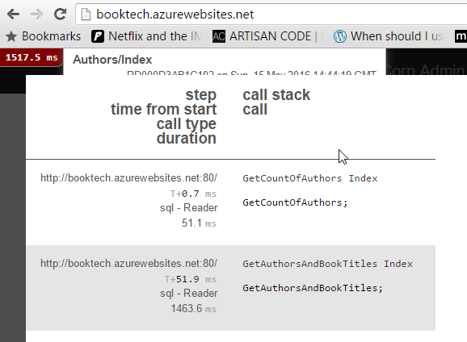
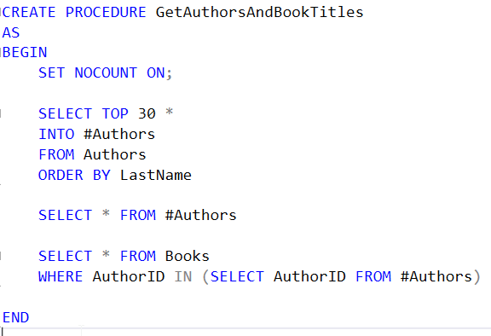
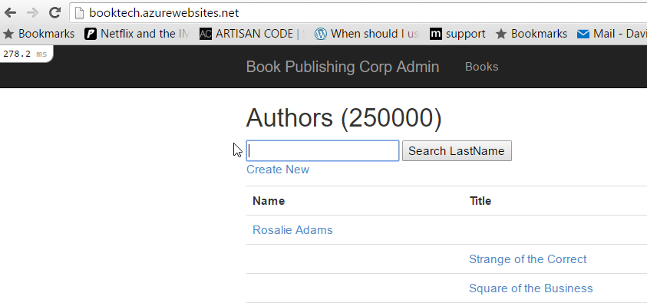
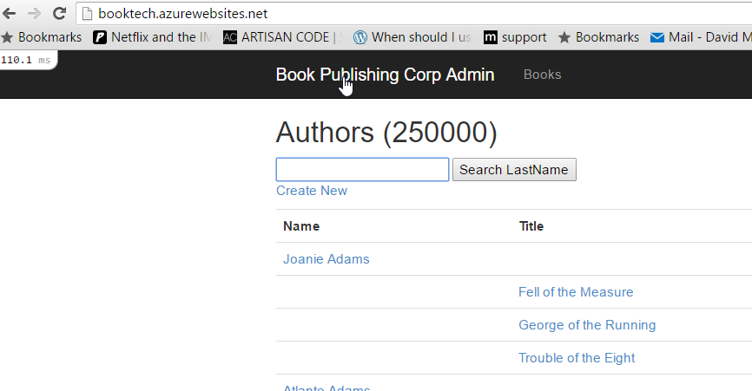
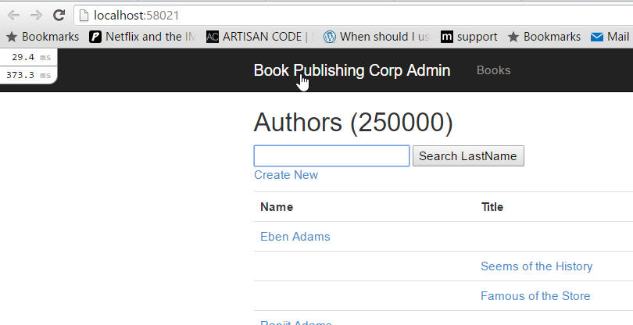
Let the DB do the work
250000 Authors, and 500000 Books.
Query executes in 1500ms (20DTU), 300ms (100DTU), or 110ms (500DTU)

Slide 29
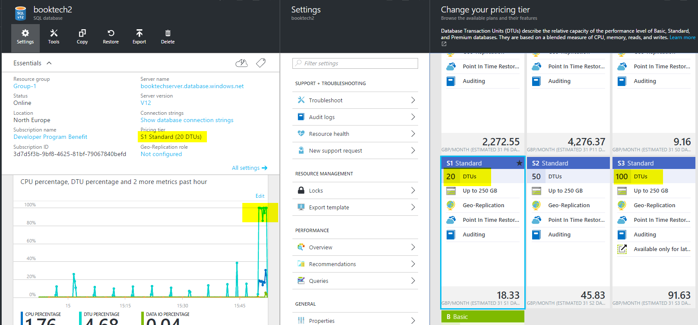

Slide 30
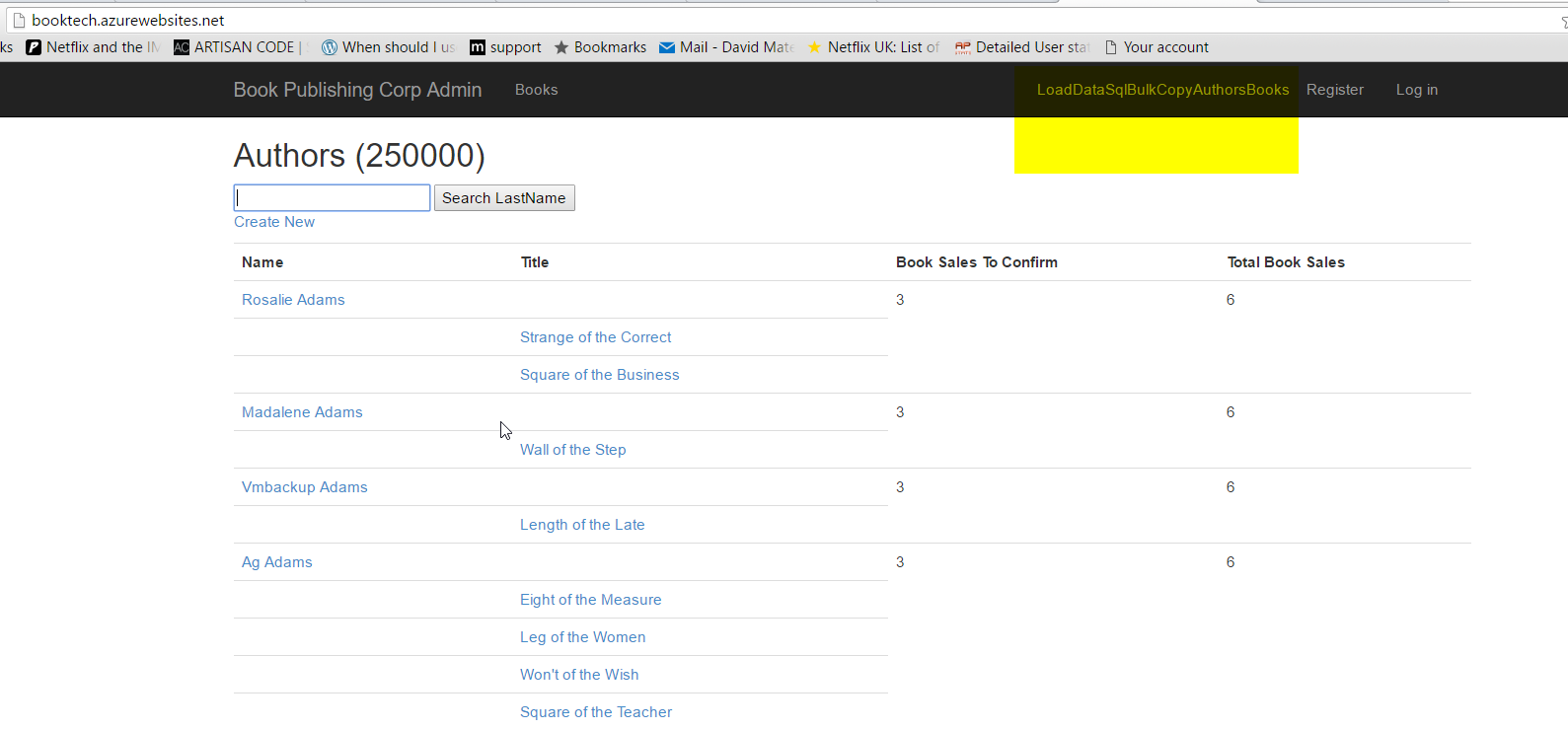

Slide 31
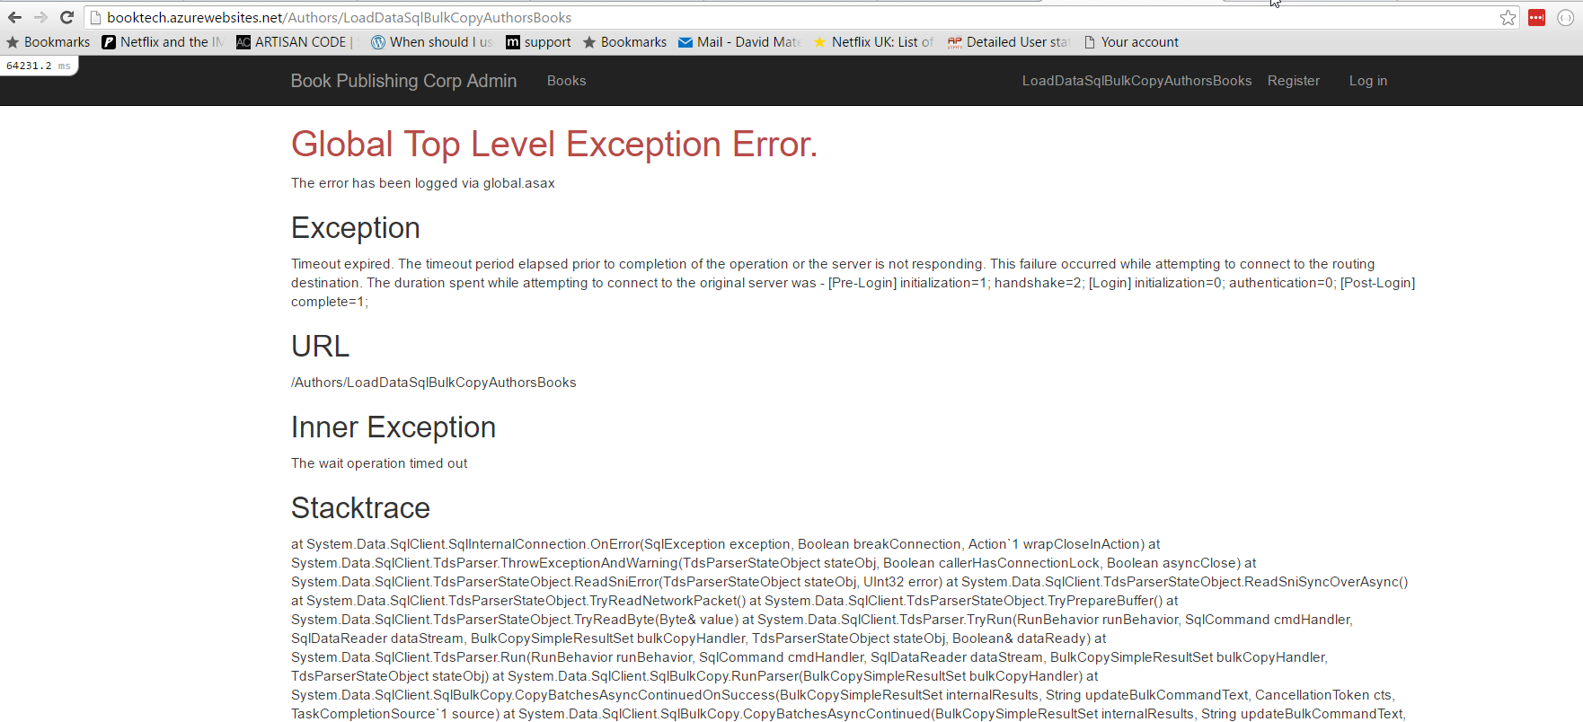
Use Exceptions for Errors
Instead of status codes or Booleans eg here is a SQL Command failing.. Want it to throw an exception

Slide 32
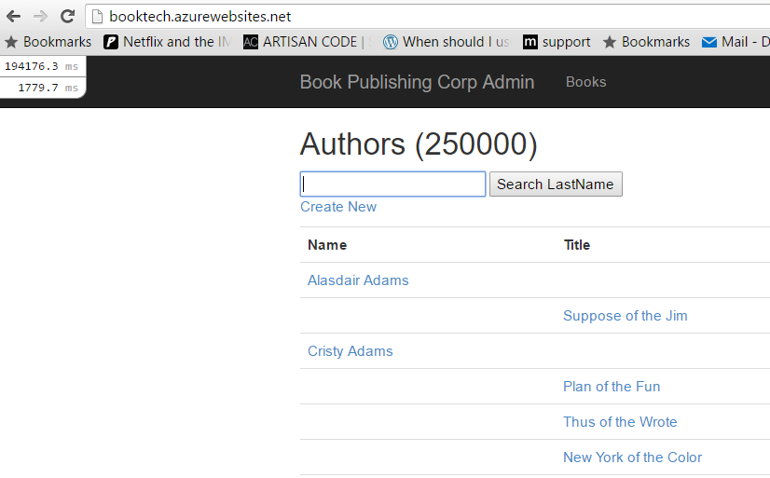
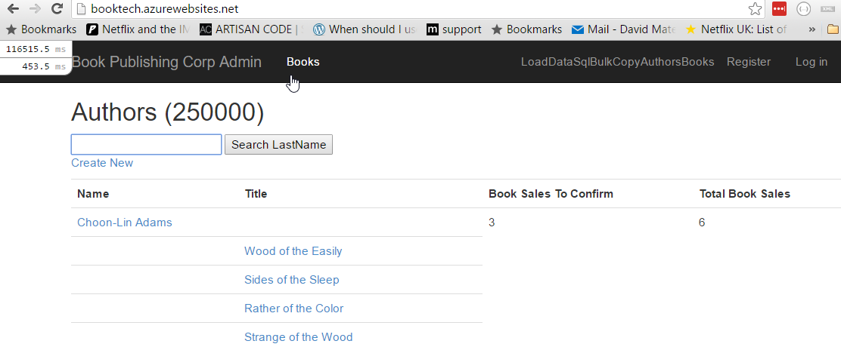
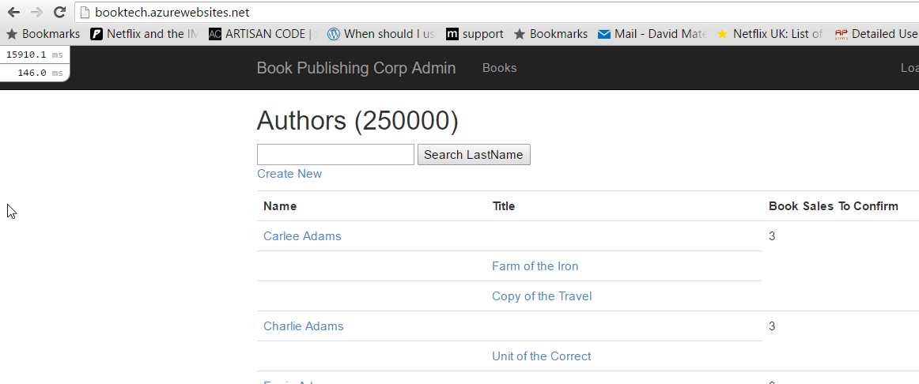
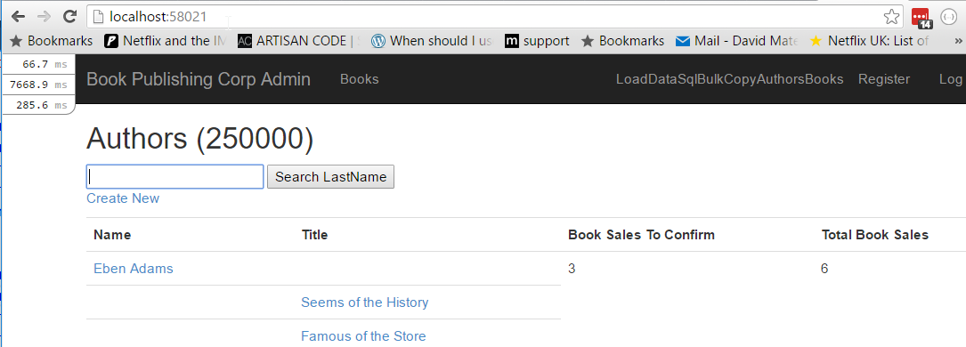

Slide 33
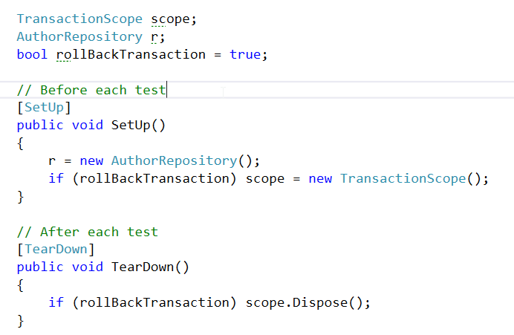
Test Repository against a DB
Have a ‘Minimal’ dataset of a few Authors and Books

Slide 34
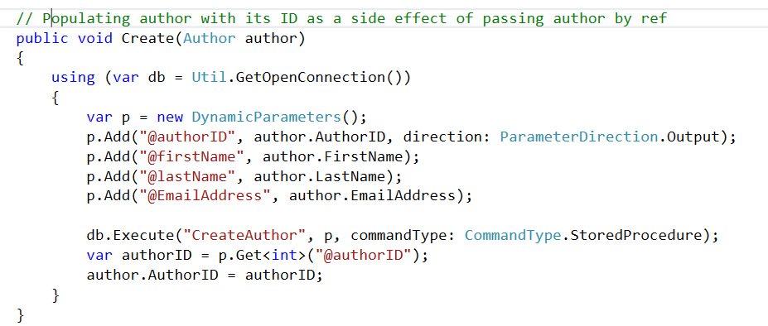
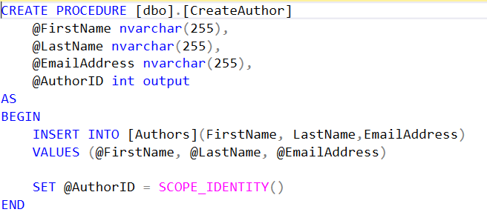
Command

Slide 35
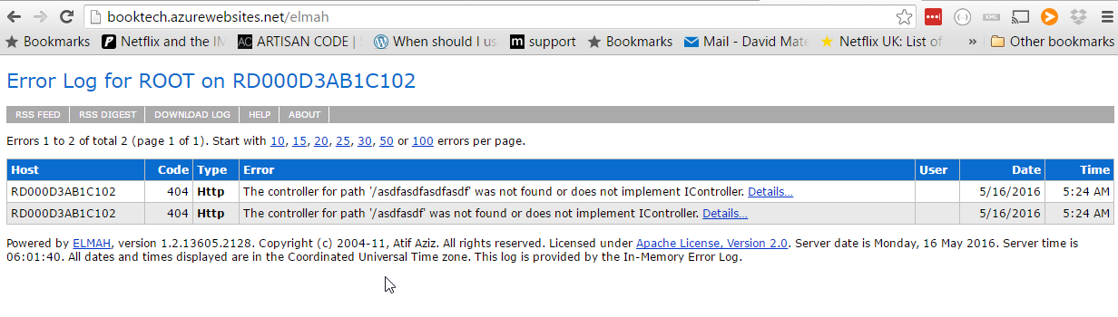
Elmah

Slide 36
Developer happiness and testability
1.Rename things
2.Kill zombies (nearly dead)
3.Favour short local names
4.Minimise comments
5.Encapsulate complexity
6.Automation / Tooling
7.Exceptions bubble up
8.Performance measure
9.Rollback transaction integration tests
10.Log
11.Favour short methods and classes!
Questions?
@dave_mateer
http://refactoring.azurewebsites.net

